Slide 1

Latent Dirichlet Allocation

Slide 2
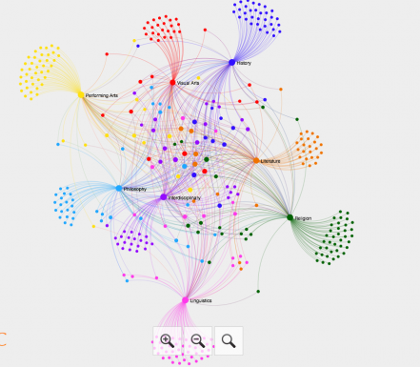
Contents
1. What is Topic Modeling?
2. What is LDA?
3. Understanding LDA in detail
'https://www.quora.com/What-is-a-good-explanation-of-Latent-Dirichlet-Allocation'
4. Running through an example
"https://www.machinelearningplus.com/nlp/topic-modeling-gensim-python/"
https://colab.research.google.com/drive/1JAQYMb_a0HSUNj1CVT8U9urieDLg7v3n

